Slide 1

SERVICE BOOKING MANAGEMENT SYSTEM
TEAM:
SHRUNGA RAVI
NIHAL RAFIQ
CHIRAG GOWDA

Slide 2

Outline
Introduction
Objective
Microservices
Use case diagram
Challenges faced
Technologies used
Screenshots

Slide 3
INTRODUCTION:
Our project is SERVICE BOOKING MANAGEMENT SYSTEM. In this, user can login and get the access to the page. User can add the products to the cart and can check the details of the product added. User can raise a request and he can check the status of the service.

Slide 4
OBJECTIVES:
These Microservices performs following operations
User management :
Register, updating and listing user details.
Product Management:
Adding, updating, listing and deleting Product.
Service Booking Management:
Creating service booking or service request and status of booking would be pending, assigned or resolved.

Slide 5
MICROSERVICES:
User Management
Product Management
Service Management
Authentication

Slide 6
USE CASE DIAGRAM

Slide 7
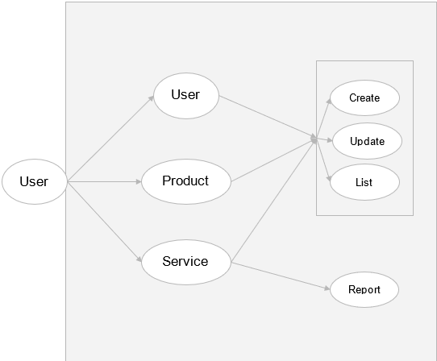

Slide 8


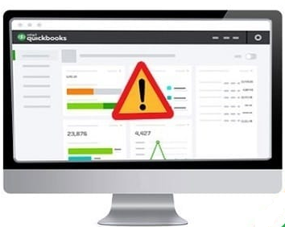

TECHNOLOGIES LEARNED:
Integration
Working Virtually
Learning new Technologies
Debugging errors

Slide 9

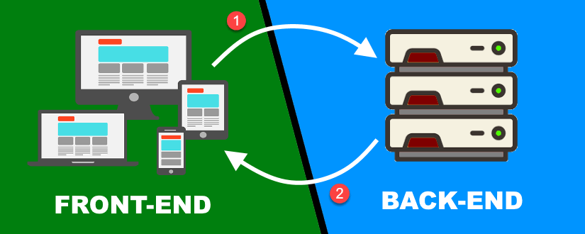
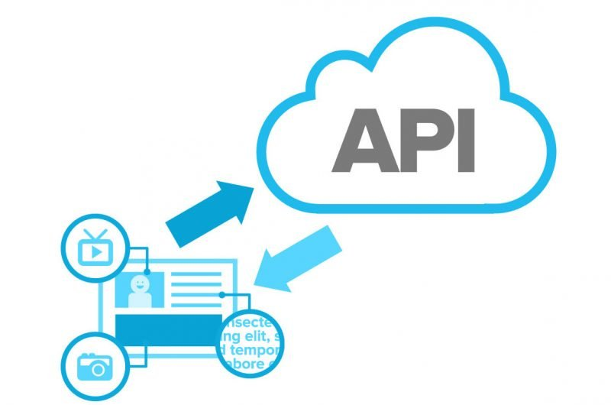
CHALLENGES :
Working remotely is one of the challenge we faces
Integrating from frontend to backend code
Fetching data from the backend
Resolving errors in coding

Slide 10






TOOLS USED :

Slide 11
SCREENSHOTS :

Slide 12
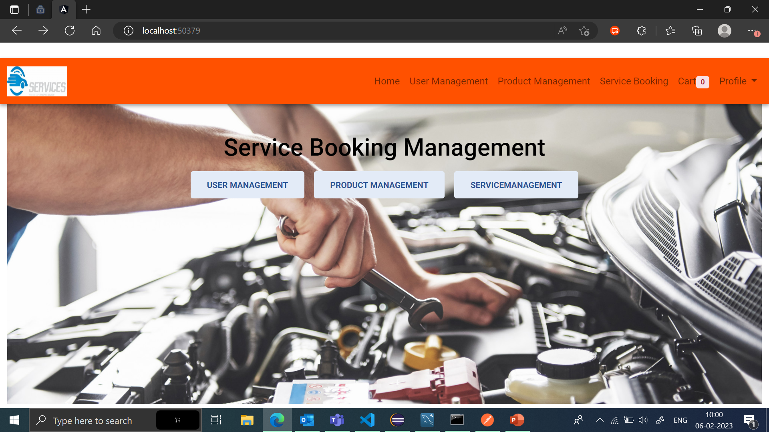
Home page:

Slide 13
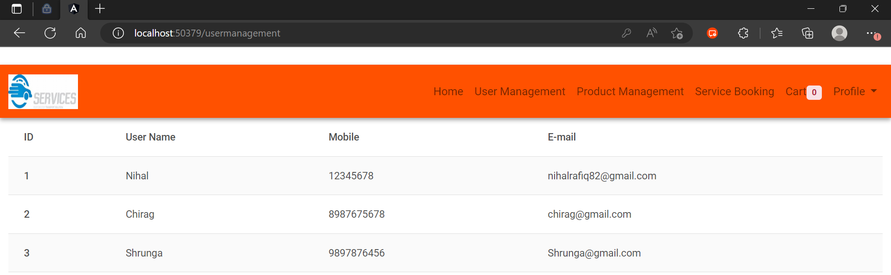
User management page:

Slide 14
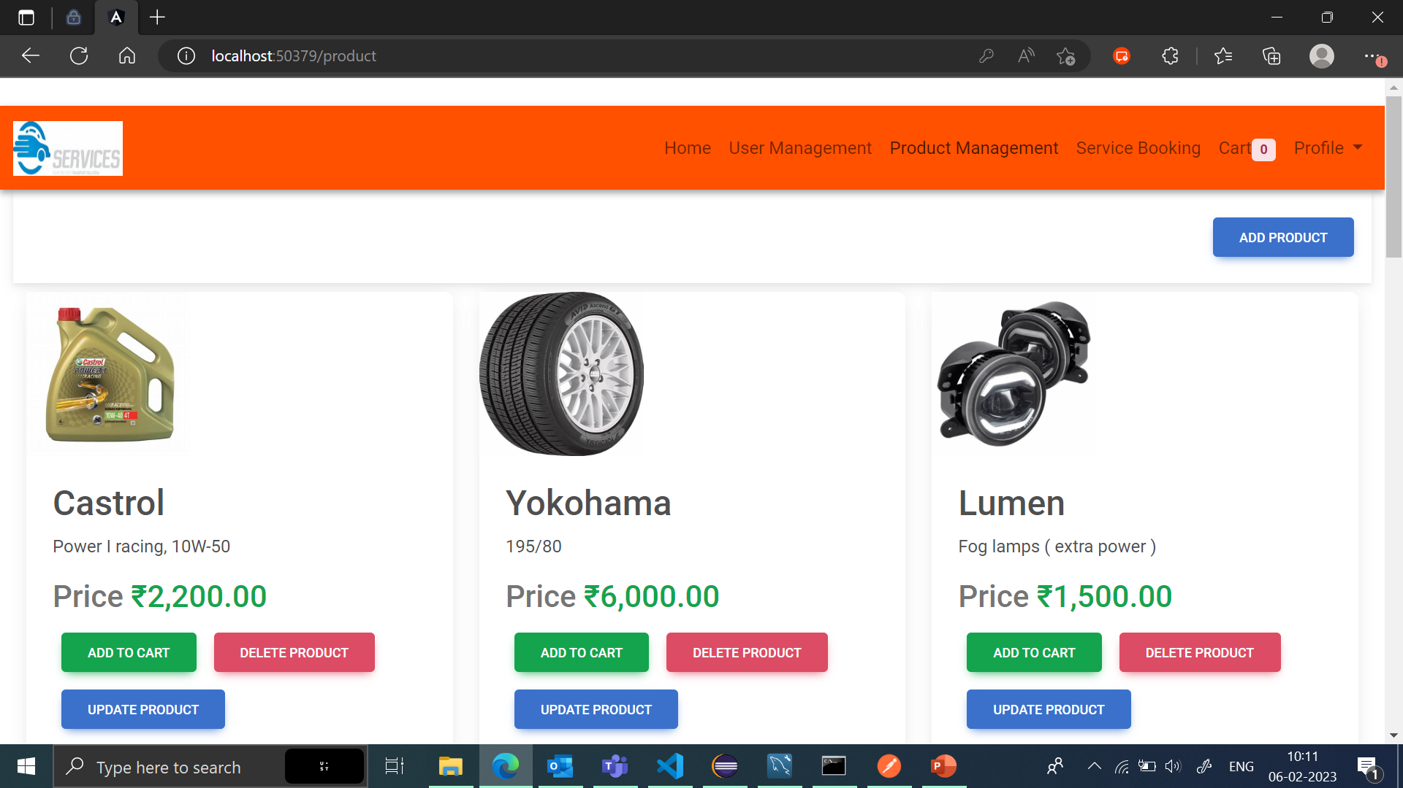
Product Management:

Slide 15
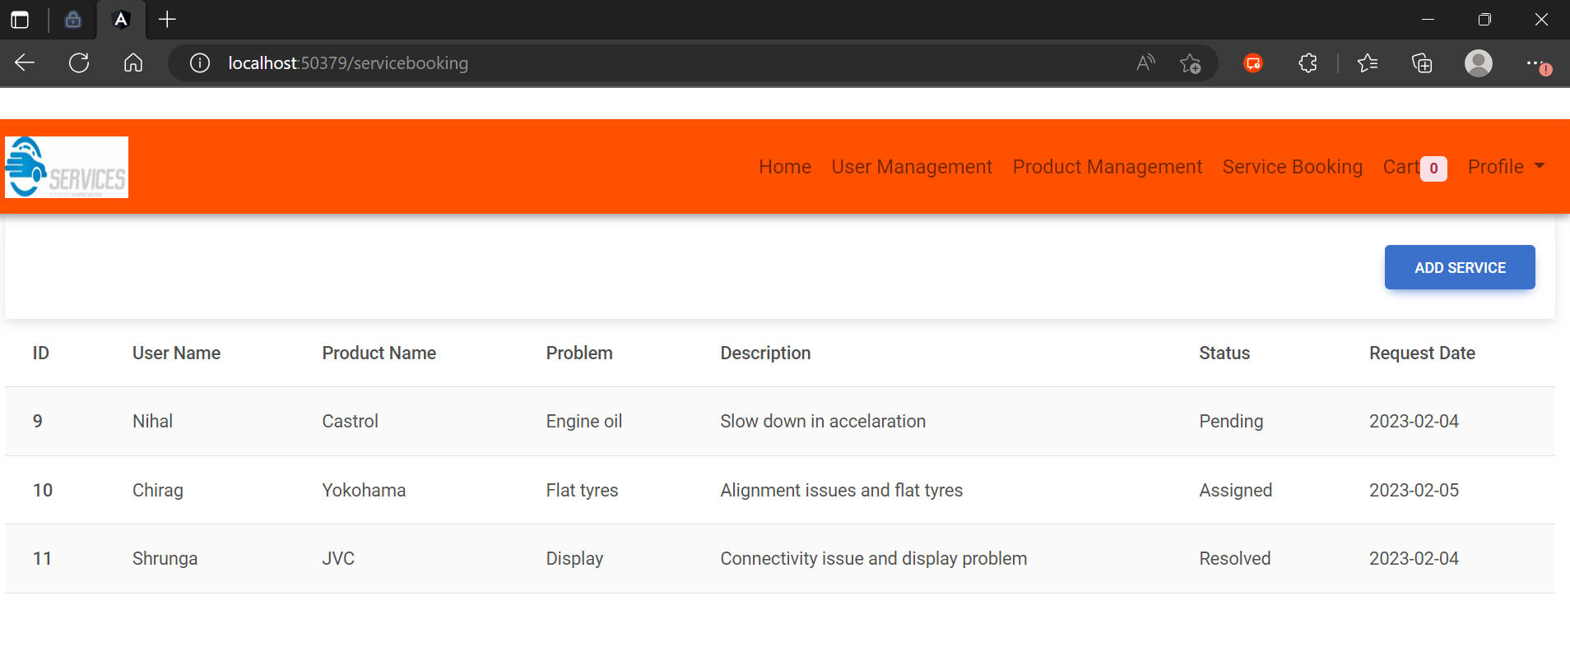
Service management :

Slide 16
THANK YOU

